Slide 1
Specification

Slide 2
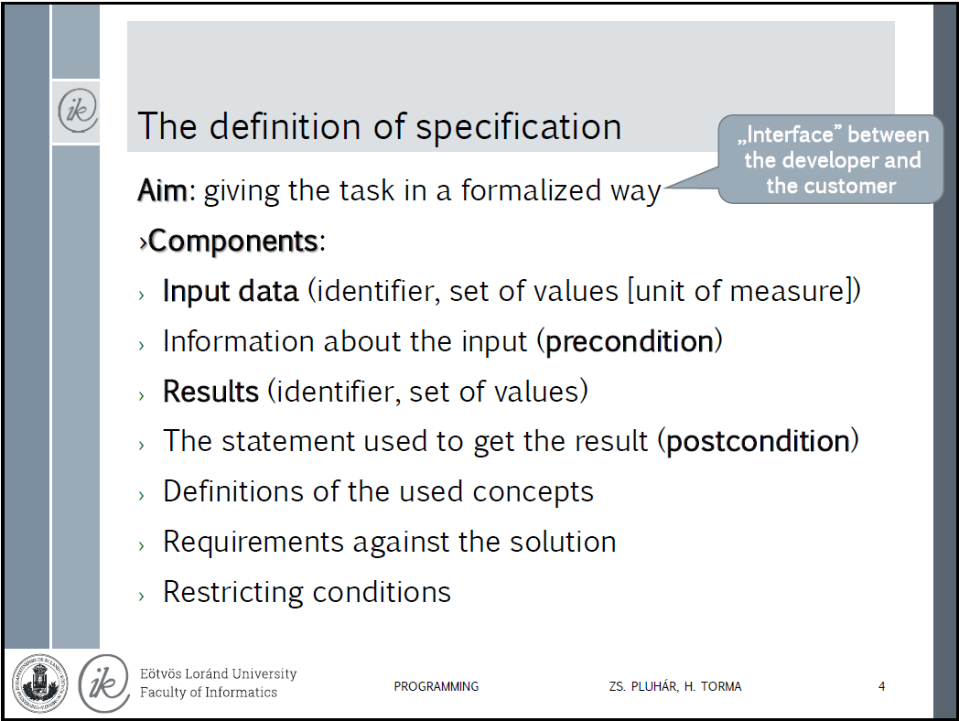
Lecture:

Slide 3
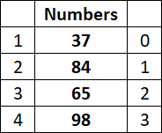
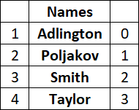
Legend 1
Count ϵ ℕ – Count is a natural number
ℕ = {0,1,2,3,4,5,6,7,8,9,10,… ∞}
Numbers_{1..4} ϵ ℕ⁴ – Numbers = {37, 84, 65, 98};
Numbers is an array (indexed set) that contains 4 natural numbers.
Name ϵ 𝕋 – Name is a string (Text)
Names_{1..4} ϵ 𝕋⁴ – Names={"Adlington", "Poljakov", "Smith", "Taylor"};
Names is an array (indexed set) that contains 4 strings.
Exists ϵ 𝕃 – Exists is a logical variable, value can be true or false

Slide 5
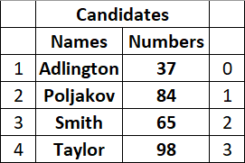
Legend 2
Candidate = Name x Number; Name ϵ 𝕋, Number ϵ ℕ
It means only one couple: (one name and one number)
Candidates_{1..Count} = (Names x Numbers)^{Count} – Is a subset of direct product of Names and Numbers.
It is an array where the elements are couples. We can store these data in a struct array.
Example: [1]: Adlington 65;
[2]: Poljakov 37;
[3]: Smith 84;
[4]: Taylor 98
Numbering, as we think about elements generally. When we create an algorithm we refer to elements that way.
Indexing, we use it during coding.
When we create an array we refer to elements that way within source code.

Slide 6
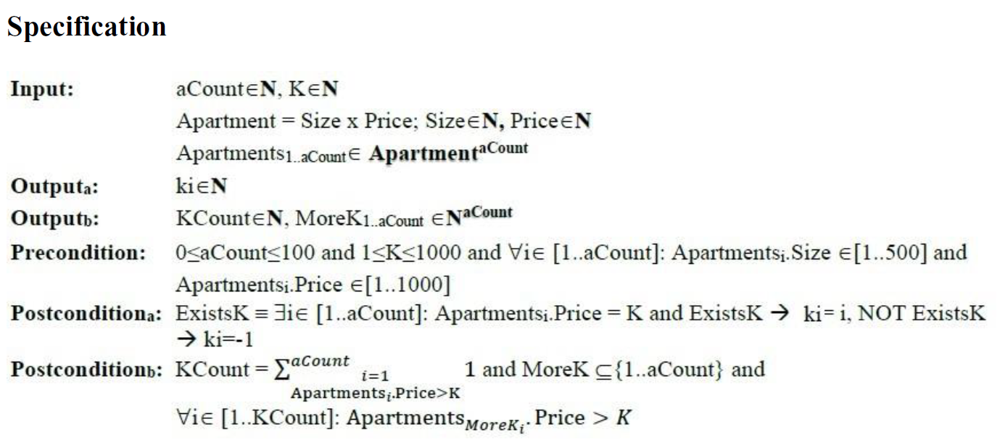
Coding test:

Slide 7


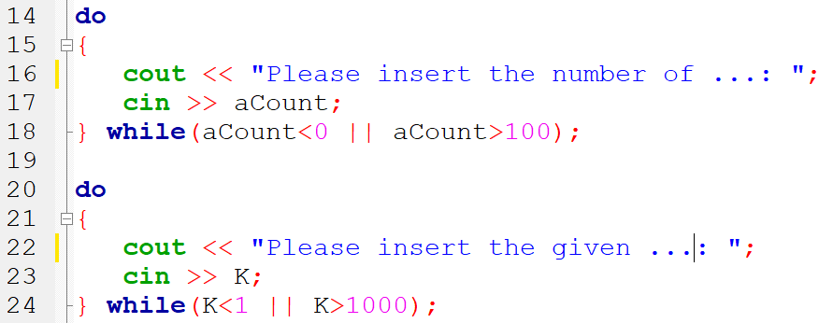


Input preconditions source code

Slide 8
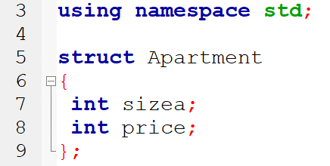

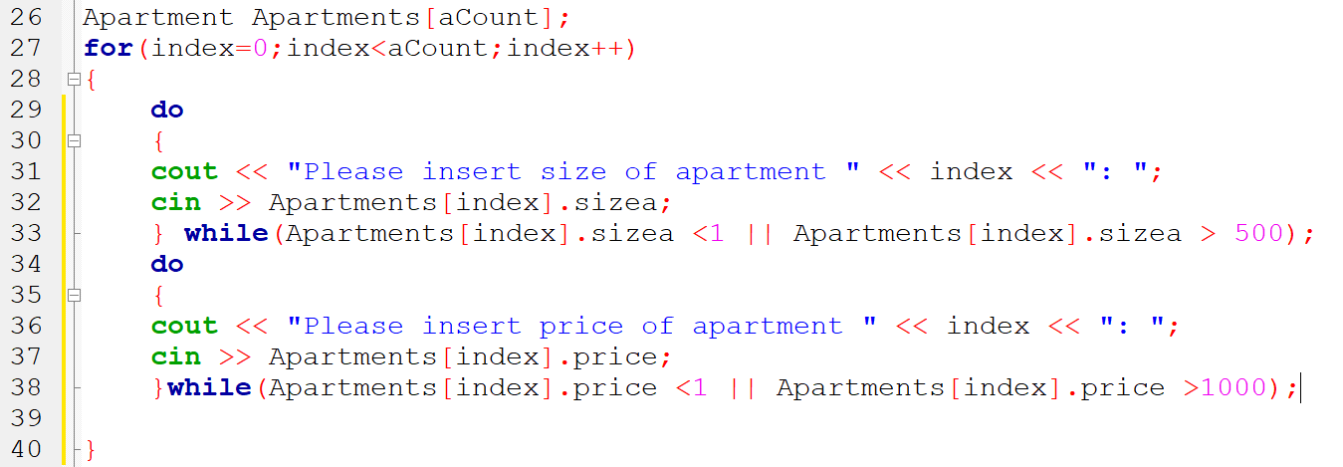
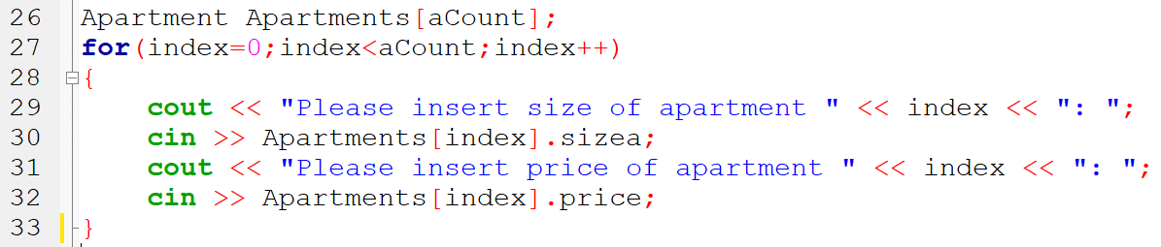
Input preconditions source code
Code without precondition checking

Slide 9

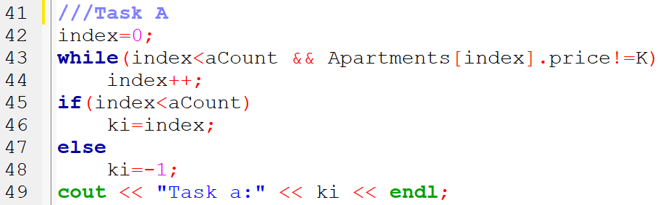
OutputA postconditions source code

Slide 10
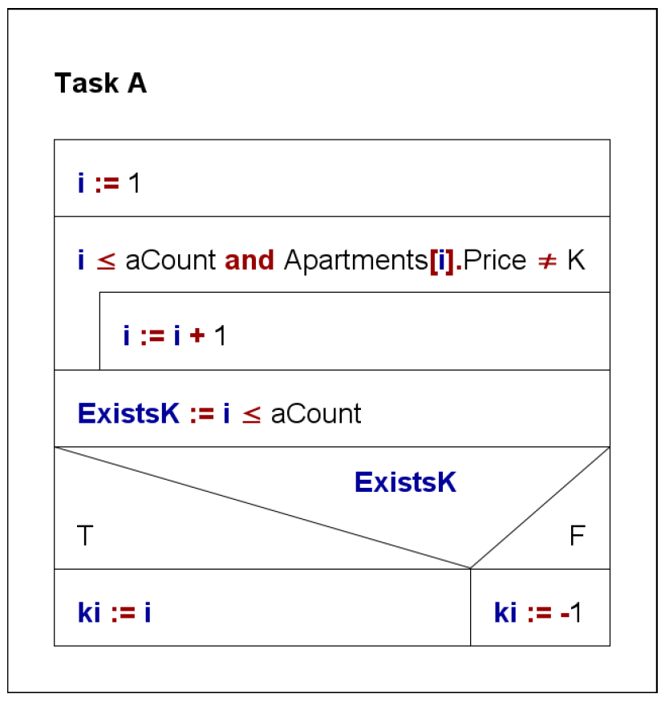
Task A algorithm and source code
The index of first element is 0 in C++
The logical expression requires WHILE loop
The index of aCount^{th} element is aCount-1 in C++

Slide 11
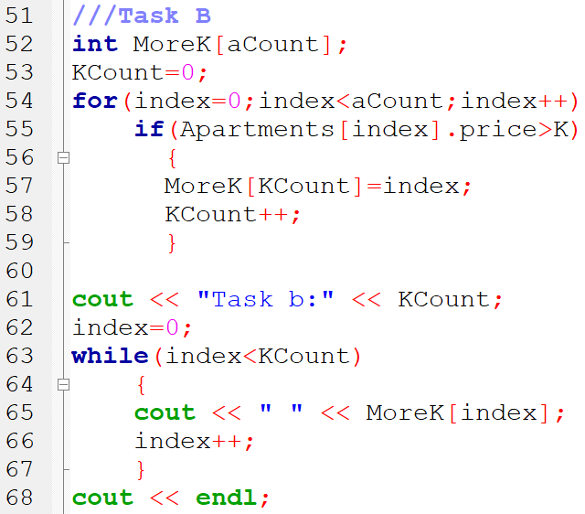


OutputB postconditions source code

Slide 12
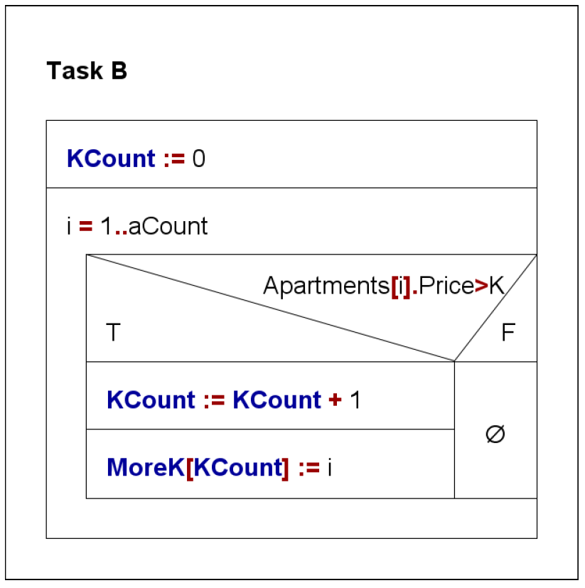
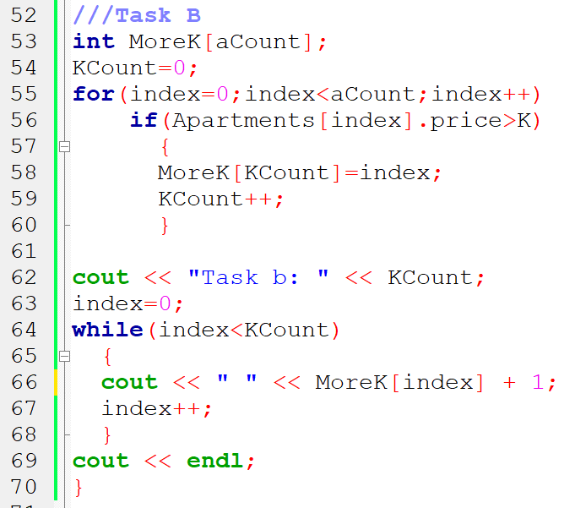
Task B algorithm and source code

Slide 13
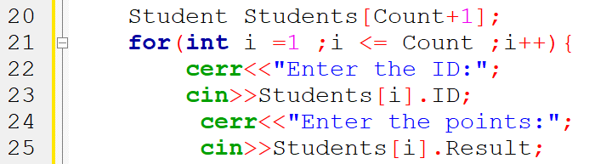
The index of first element is 0 in C++
There are several possibiities to handle this issue. Talal presented a smart solution. You must create an array that can contain one more element.
In this case, the first element of array is not used: Students[0] element is blank

Slide 14
The End

